Slide 1
Design Pattern : Factory Method Rajsing Jadhav

Slide 2
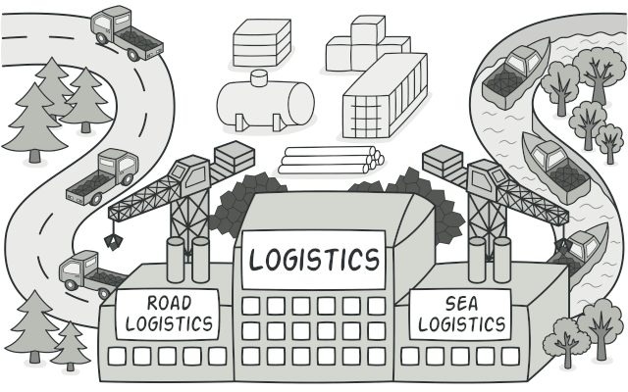
Introduction to Factory Method
The Factory Method Design Pattern is one of the creational design patterns, which is used to deal with object creation mechanisms, trying to create objects in a manner suitable to the situation. This pattern defines an interface for creating an object but allows subclasses to alter the type of objects that will be created. It's particularly useful when the exact type of the object isn't known until runtime or when the process of object creation should be decoupled from the client.
It helps in the creation of objects in a flexible way by providing a common interface to instantiate objects, without specifying the exact class of object that will be created. e type of objects that will be created. It's

Slide 3
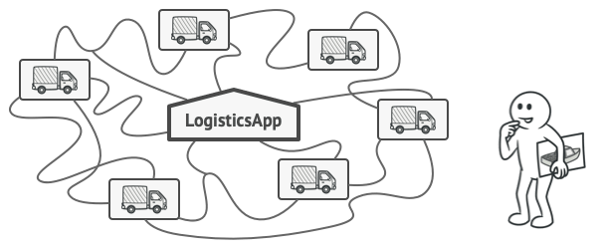
Concepts of the Factory Method Pattern & Structure
Decouples Object Creation:
The pattern decouples object creation from the client. The client doesn't need to know how objects are created, just that they can be created via a factory method.
Extensibility:
If new types of objects need to be created, subclasses of the factory can be added without modifying the existing client code.
Flexibility:
It allows you to change the type of object being created without affecting the client code that relies on the factory.
Abstracts Complex Object Creation:
If the creation of objects involves complex logic, the Factory Method abstracts this complexity from the client.

Slide 4
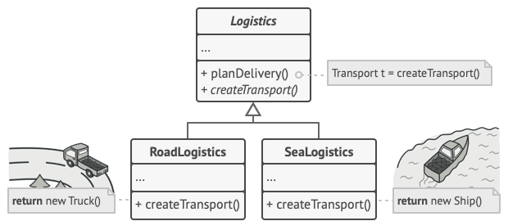
Why Use the Factory Method Pattern?
Product: Defines the common interface for all products
This is the interface or abstract class that defines the common behaviour of the objects that are created.
Concrete Product: Implements the Product interface.
These are the actual objects that implement the Product interface or class.
Creator: (Abstract Class) Contains the factory method, which is used to create the product.
This is the abstract class or interface that declares the factory method. It may define a default implementation for the factory method.
Concrete Creator: These are subclasses of the Creator class that implement the factory method to return an instance of a Concrete Product.

Slide 5
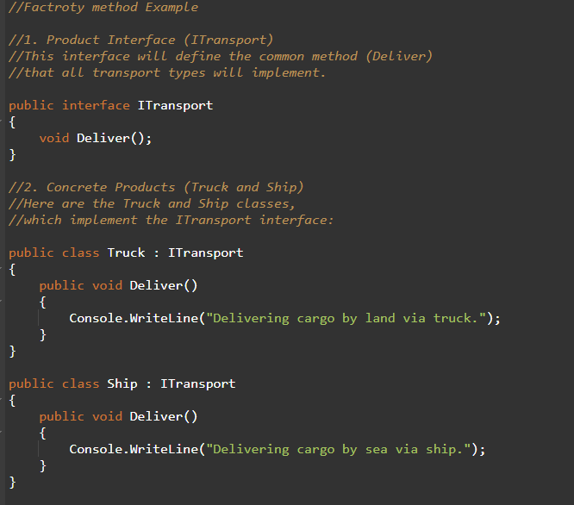
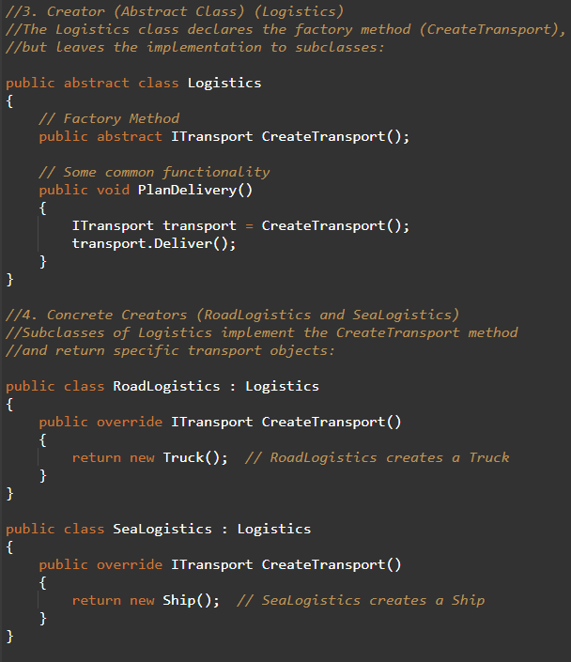
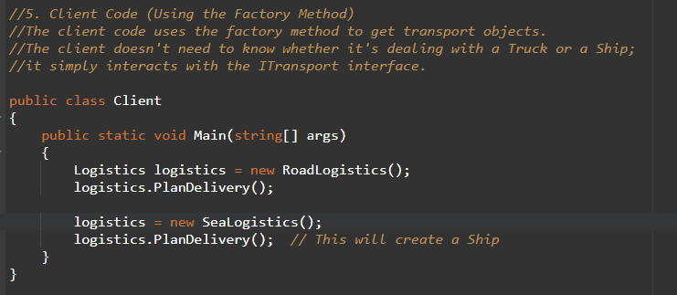
Code Walk-through
OUTPUT : Delivering cargo by land via truck. Delivering cargo by sea via ship.

Slide 6

Application in ECOMMERCE
1. Product Creation
To dynamically create different product types (e.g., electronics, clothing) based on conditions. Decouples product creation logic from the client code.
2. Service Layer
To select the appropriate service for handling different types of products (e.g., regular vs discounted).Allows flexible service management without modifying client code.
3. Order Processing
To dynamically choose the correct order processing service (e.g., rush order, international order).Simplifies order processing logic and keeps it extensible.
4. Inventory Management
To create different inventory management systems (e.g., warehouse inventory) dynamically.
Factory Method for Database Connections
Defined a Database Connection Interface
Interface: IDatabaseConnectionFactory
Method: CreateConnection() for creating database connections.
Implement Concrete Factories for Each Database
SQL Server Factory: Creates a connection for SQL Server.
MySQL Factory: Creates a connection for MySQL.
Oracle Factory: Creates a connection for Oracle.

Slide 7

When to Use Factory Method
Creating objects without specifying the exact class of the object.
Complex creation process involving multiple operations.
Open to extensions, allowing new object types without modifying existing code.
Decoupling code from specific object types used.
Advantages of the Factory Method
Improved Code Maintainability: The Factory Method Pattern centralizes object creation, making it easier to maintain and modify.
Separation of Concerns: The pattern separates the client code from the object creation process.
Open/Closed Principle: You can add new types of products without modifying existing code, adhering to the Open/Closed principle.
Disadvantages of the Factory Method
Increased Complexity: Introducing a factory method can make the system more complex by adding additional classes and layers.
Subclasses Are Required: The client code might need to use subclasses to create different types of objects.

Slide 8

Conclusion
The Factory Method design pattern is an excellent solution when your application needs to create instances of different types of objects (e.g., different types of transportation) but without coupling your code to specific classes. It provides flexibility and extensibility while promoting code maintainability. By delegating the responsibility of object creation to subclasses, it allows the system to evolve without requiring changes to client code

Slide 9




THANK YOU
(844) 720-6678
info@simplifyhealthcare.com
simplifyhealthcare.com
Simplify Healthcare
U.S.: 600 N Commons Drive, Suite 110, Aurora, IL 60504
India: 401/402, 4th Floor, Pentagon P-2, Magarpatta City, Pune 411013
CONNECT WITH US
LinkedIn
YouTube
X
Instagram

